Slide 1

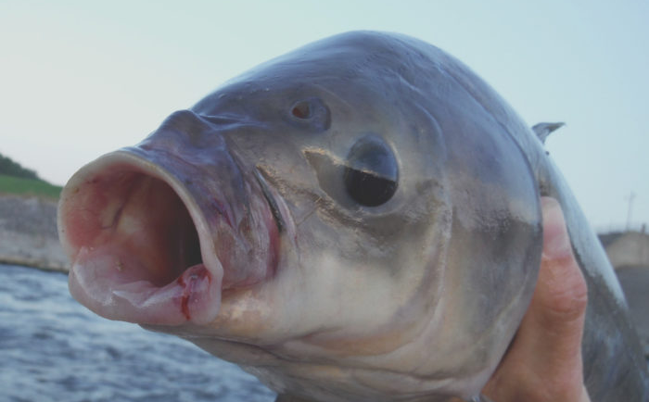
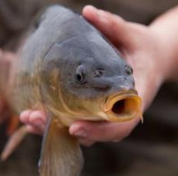
Modeling factors that affect carp and buffalo electrofishing catchability
Marty Simonson, Brandon Maahs, Bobby Cope

Slide 2
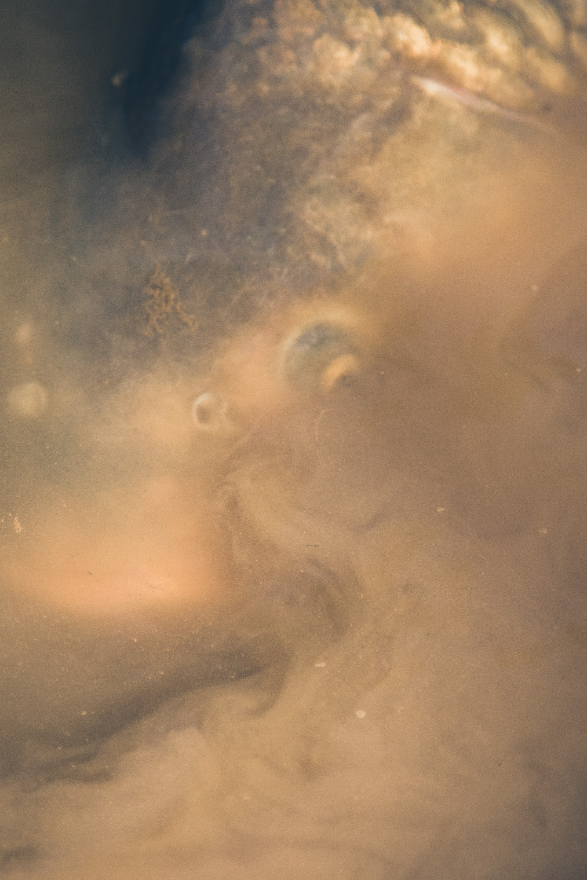
“Rough” Fish
Generally considered a nuisance
Increase turbidity through resuspension of sediments
Impacts nutrient levels, macrophyte growth, wildlife
Frustrates anglers and non-anglers

Slide 3
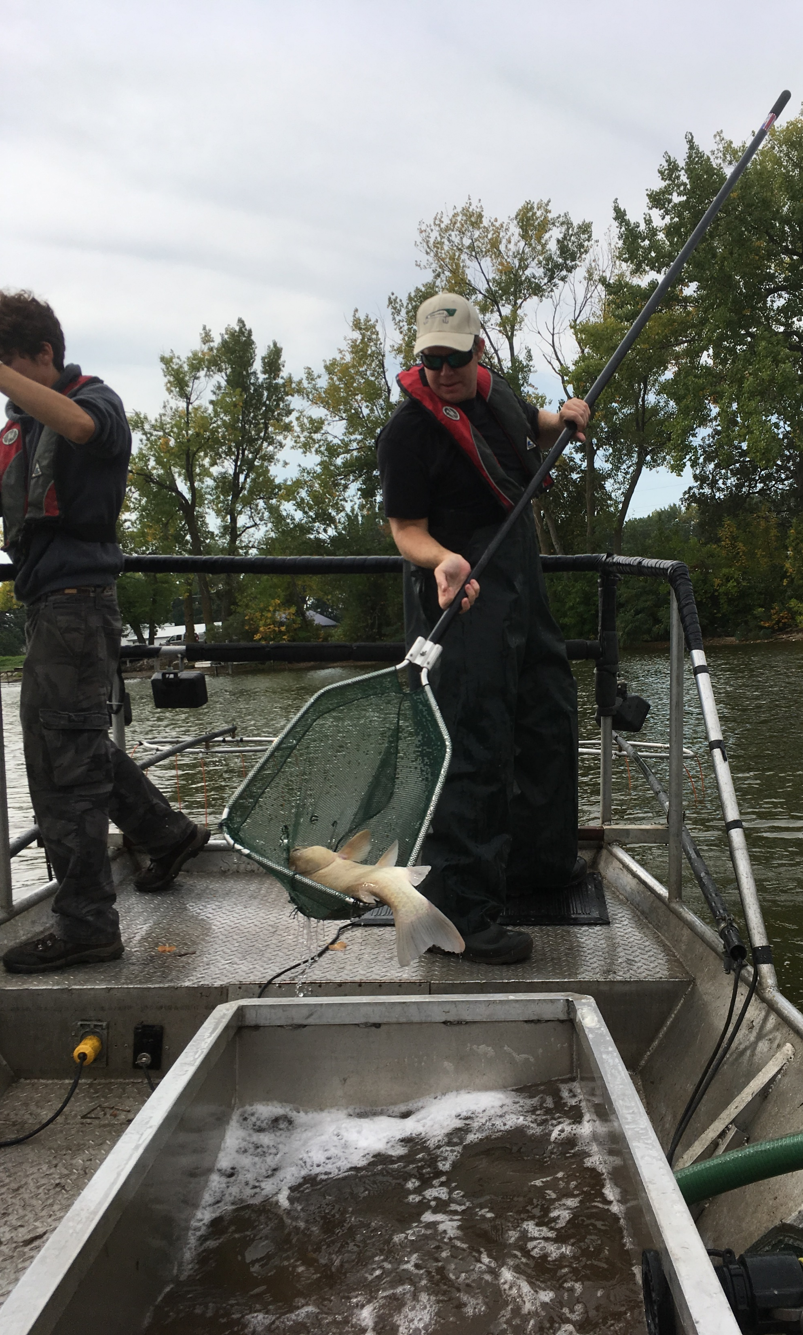
Sampling Fish Populations
Electrofishing:
-Commonly used for game and non-game species
-use of electricity to temporarily stun fish
Catch per unit effort (CPUE):
-IF CPUE is directly proportional to population size, relative abundance can be estimated

Slide 4
Catchability
Probability of catching a fish in one unit of effort
Catchability changes:
-fish activity patterns
-weather
-water quality changes
CPUE/catchability = N
*Difficult to describe relationship between CPUE and Catchability*

Slide 5
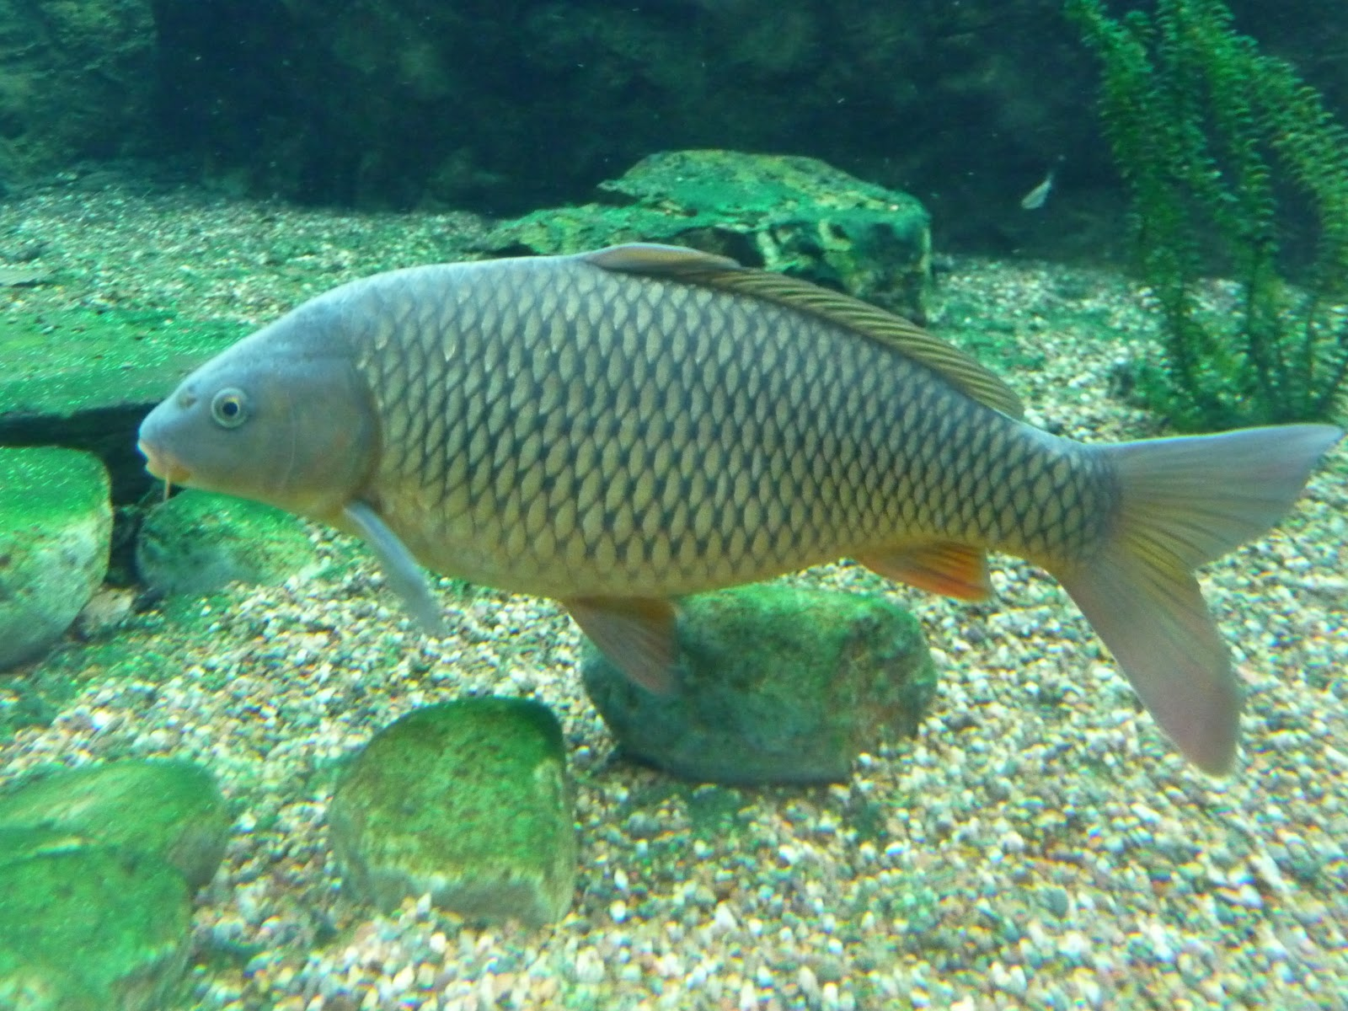
Objective 1
Determine if noon wind speed and noon air temperature impact electrofishing catchability of Common Carp.

Slide 6
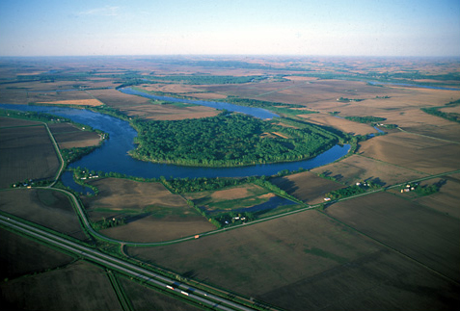
Study Site
Blue Lake
Monona county
269 acres
Max depth= 11.7ft
Lots of carp but closed system

Slide 7
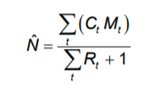
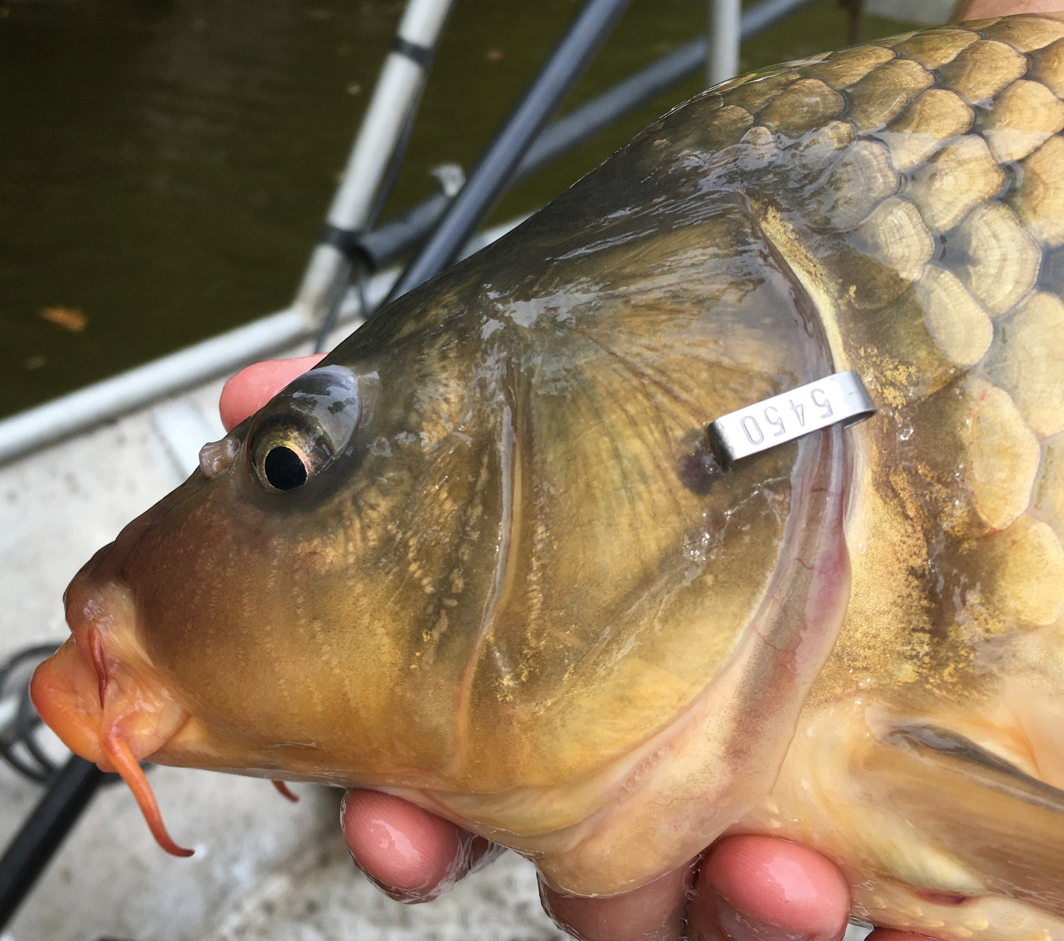
Estimating population size
Mark-Recapture
-Electrofishing
-Individually numbered tags
-Marking on all occasions
-Multiple recapture events
Ct= Total # caught in sample t
Mt= # marked in pop. just before t sample taken
Rt= # marked in sample t
Schnabel population estimate
-Extension of the Lincoln-Peterson
-Multiple resampling
-Independent from CPUE data

Slide 8
Schnabel pop est.
Observation error
Pop size (N)
CPUE
1
CPUE
CPUE
2
26
Catchability
Noon air temp.
Noon wind speed

Slide 9
Methods: Analysis
Bayesian model approach
2 independent datasets
Population estimate
Observed CPUE
Latent Variables
Catchability
Expected CPUE
Covariates
Noon air temp
Noon wind speed

Slide 10
Priors
Log N
sd
B0
B1
B2
Latent Variables
Expected
Log CPUE
Catchability
tau
Data
Log Schnabel estimate
Air temp
Log CPUE
Wind
sd Log Schnabel estimate
tau N

Slide 11
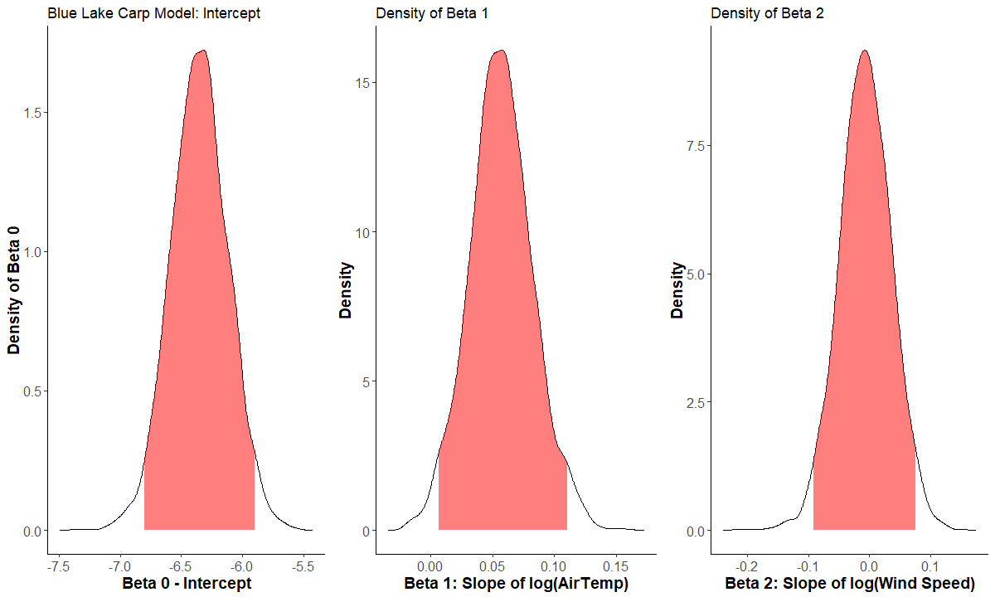
Results: Blue Lake

Slide 12
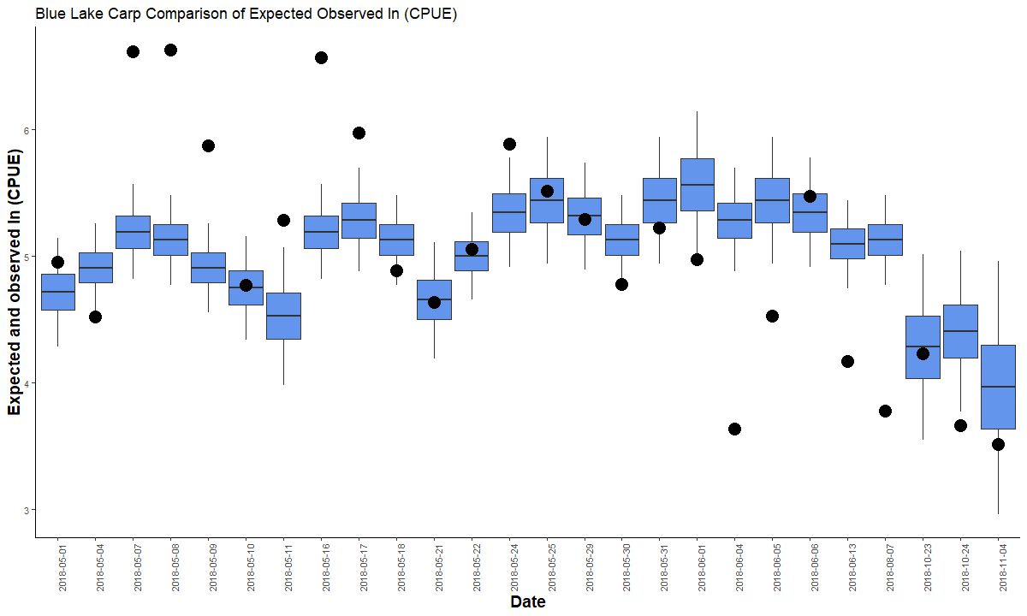
Results: Blue Lake

Slide 13
Results: Blue Lake
Wind speed is not important influence of CPUE
Air temperature has slight positive slope
What about water temperature?
Would Buffalo have the same response patterns as Common Carp?

Slide 14
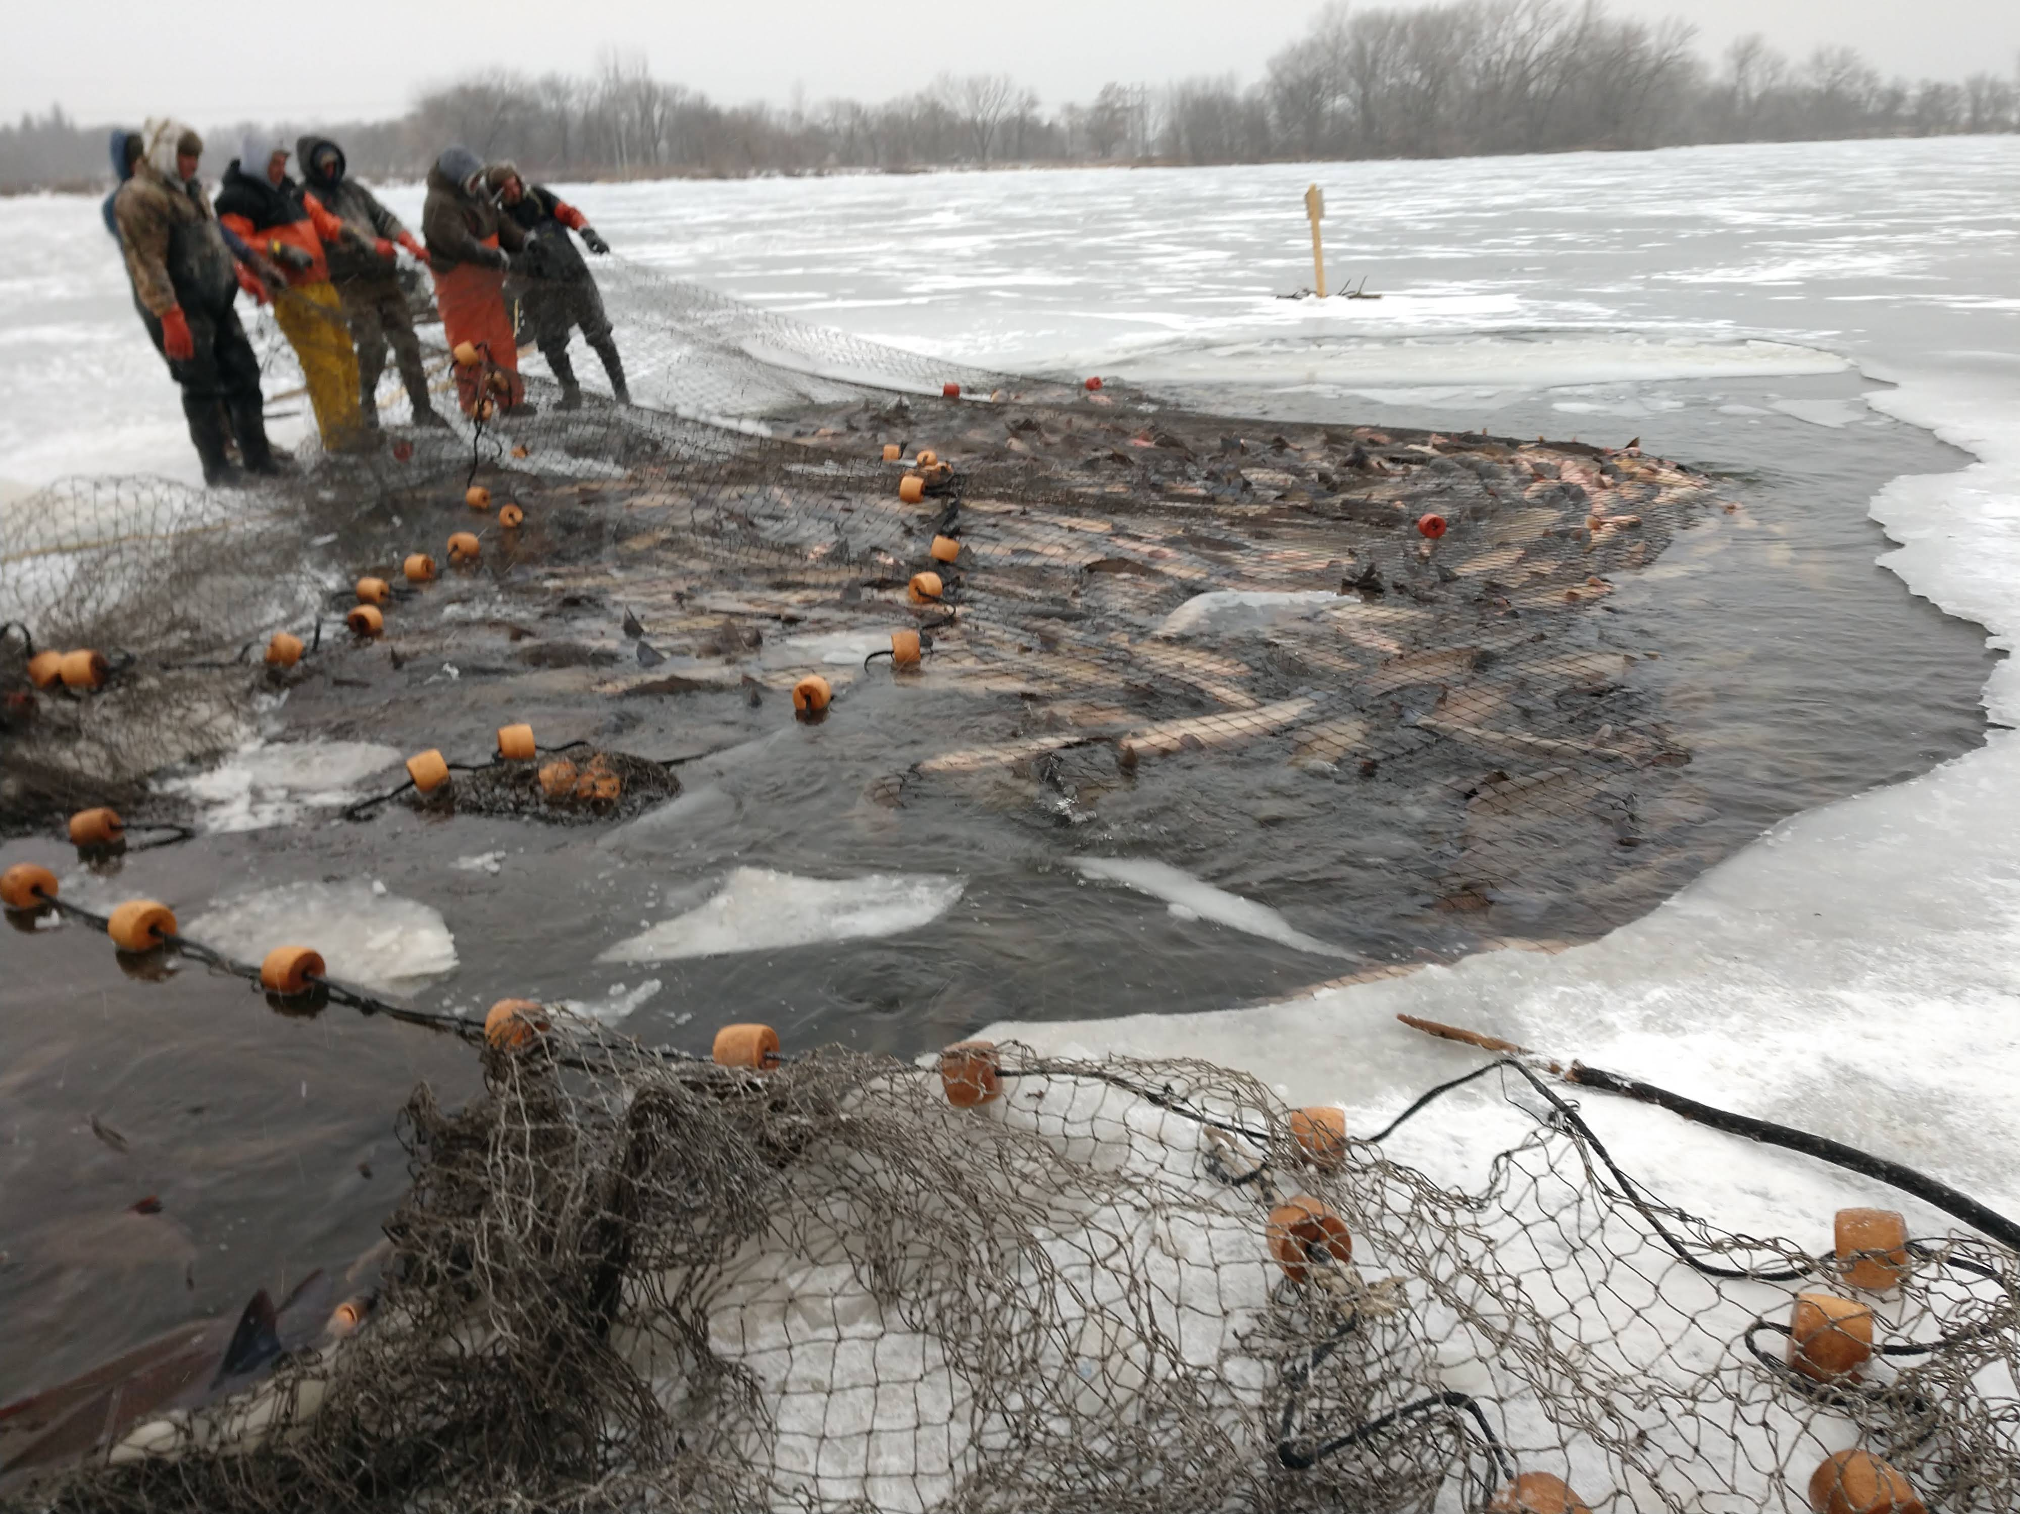
Objective 2
Identify if water temperature affects CPUE of Common Carp and Bigmouth Buffalo in North Twin Lake
North Twin Lake
Calhoun county
453 acres
Max depth = 12 ft

Slide 15
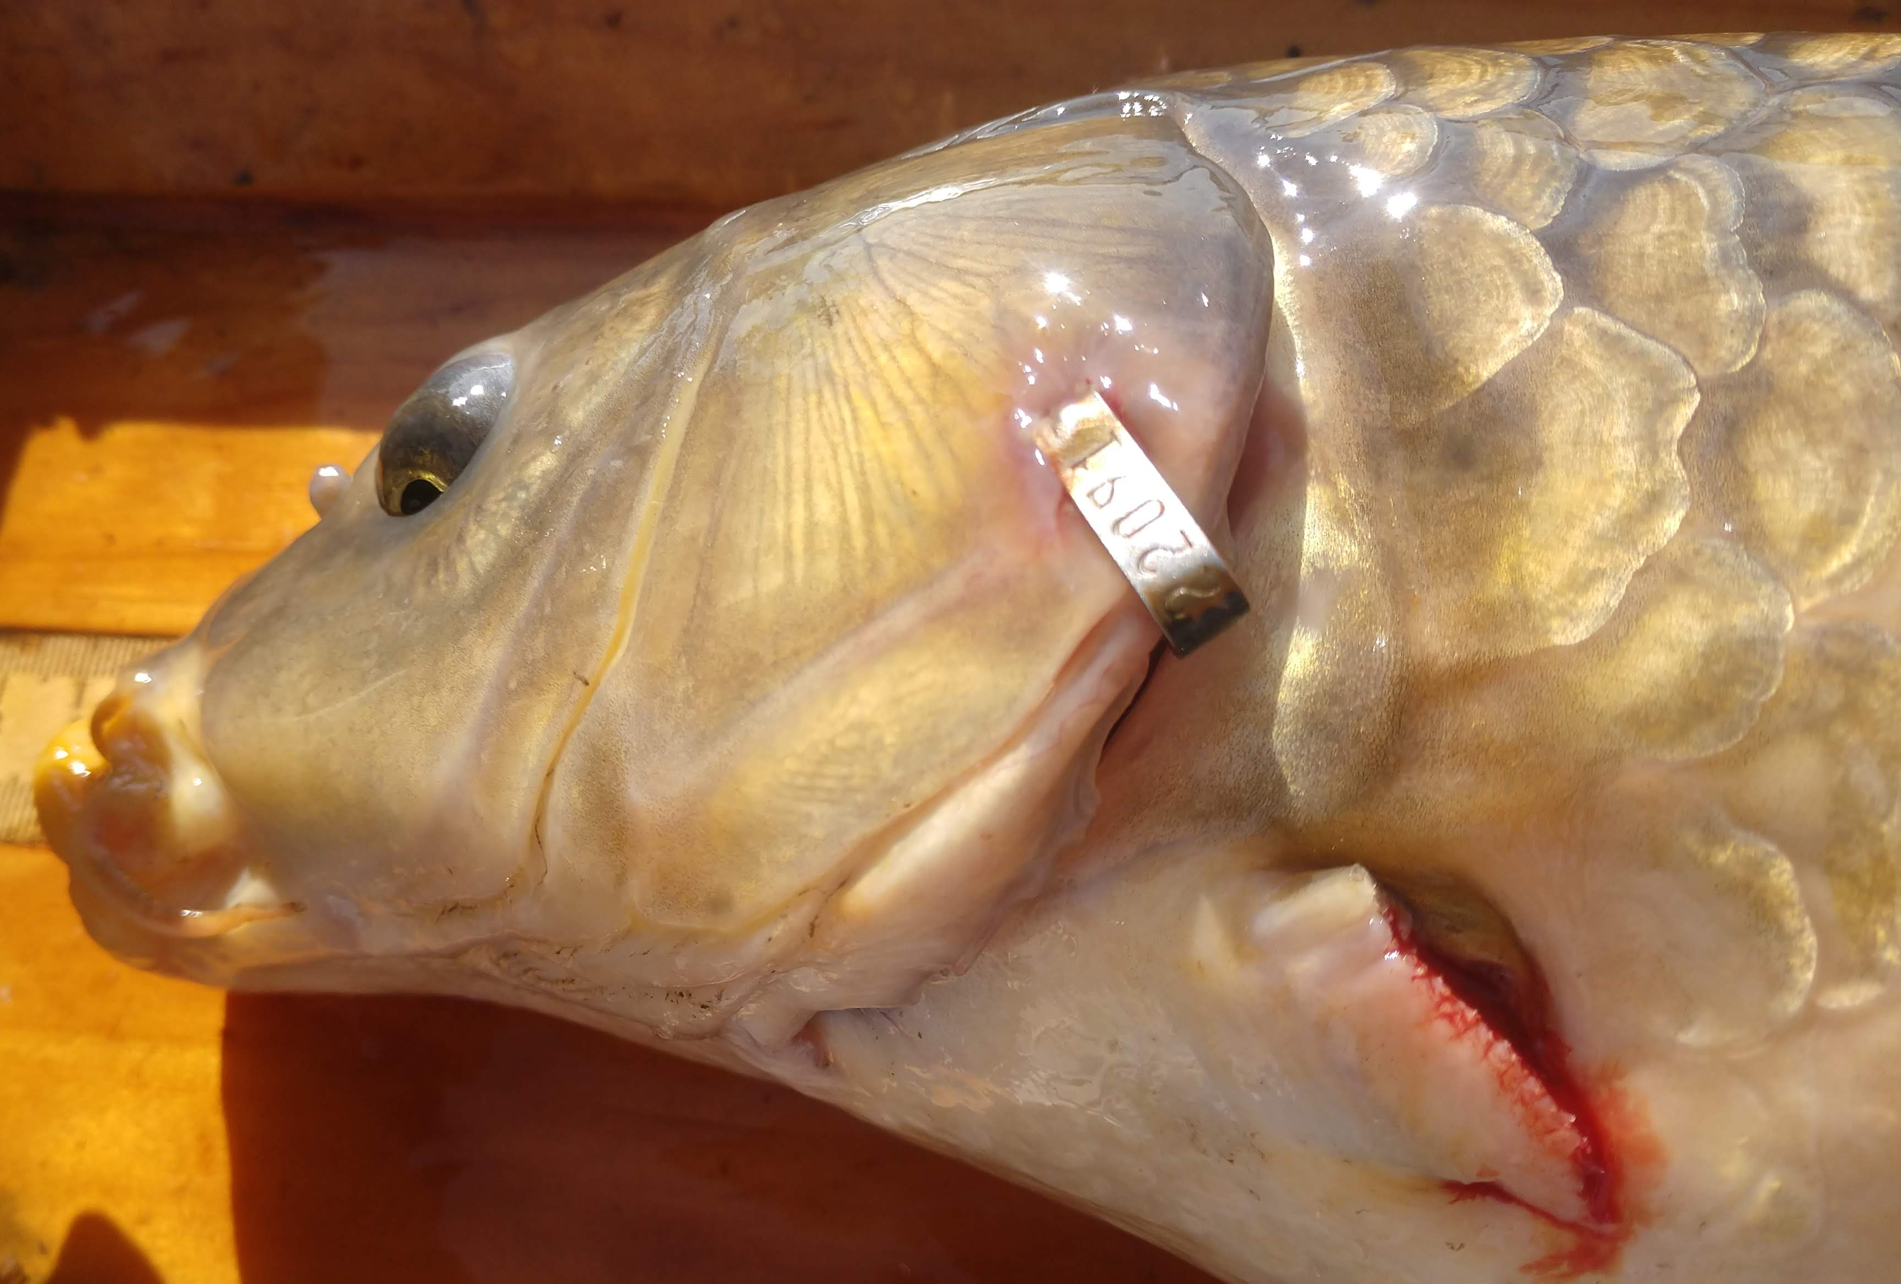
Analysis: North Twin Lake
Use same modeling approach
-Schnabel population estimate with CPUE data
- Expected CPUE and catchability latent variables
Reduced model
Removed air temp and wind speed
Added water temp

Slide 16
Priors
Log N
sd
B0
B1
Latent Variables
Expected
Log CPUE
Catchability
tau
Data
Log Schnabel estimate
Water temp
Log CPUE
sd Log Schnabel estimate
tau N

Slide 17
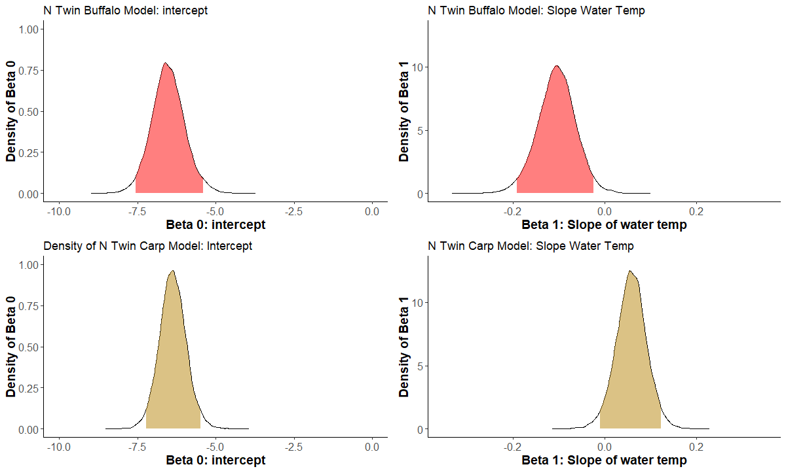
Results: North Twin Lake

Slide 18
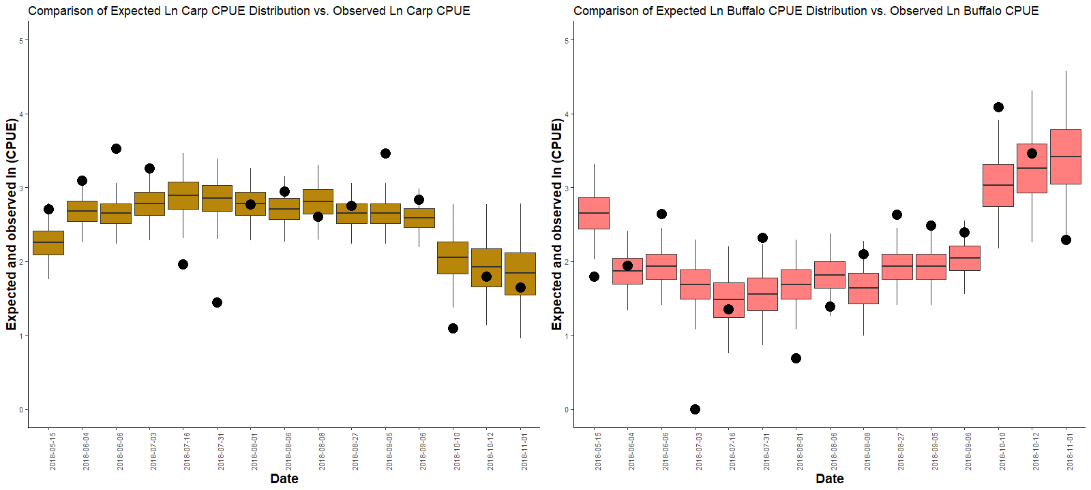
Results: North Twin Lake

Slide 19
Future considerations:
Include lake specific covariates to compare between lake effects
Surface area
Mean depth
Shoreline development index
Bathymetry
Explore how sensitive our model is to changes in variables

Slide 20
What we learned:
Catchability was extremely low for both systems and species
Blue Lake model
Wind speed had no effect on catchability
Air temp had little effect on catchability in Blue Lake
North Twin Lake:
Water temp had small effect on Buffalo catchability and no effect on carp catchability
Both systems had variability in observed CPUE that was not explained in our model
There are other unknown variables to explore

Slide 21
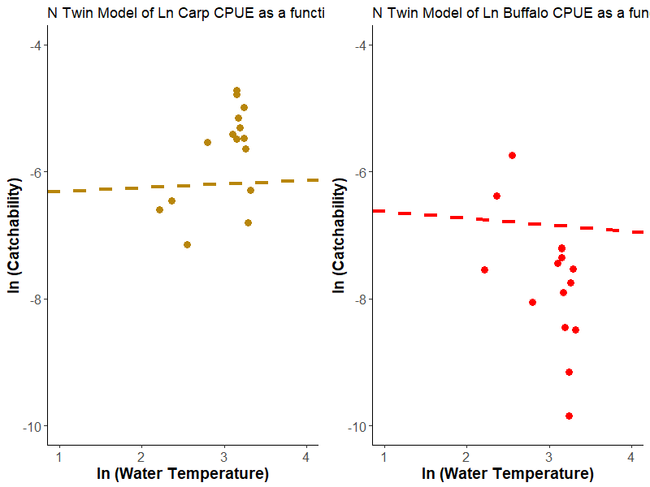
Results: North Twin Lake
Ln Carp CPUE
Ln Buffalo CPUE

Slide 22
What to present from Dixon
Context (why is the question interesting)
Your model (how you approached your question)
Each group is using latent models in a different way so describe your own latent variable
What are the latent variables?
The reduced diagram
What you learned
Along the lines of what your question was
15min talk, 5 min for questions
2:15pm Wednesday

